Slide 1
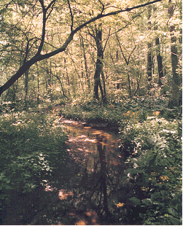
Overview of Ecosystem Planning & Management
Lecture # 1
Dr. Samuel Brody, TX, A&M University

Slide 2
Traditional Resource Management Not Sufficient
75% of major fish stocks depleted from over fishing or fished to biological limit (Garcia and Deleiva, 2001).
Logging and conversion have shrunk forest cover by as much as half (Bryant et al., 1997).
58% of coral reefs are threatened by human activities (Bryant et al., 1998).
65% of world cropland experience soil degradation (Wood et al., 2000).
Notes:
From

Slide 3
Traditional Resource Management Approach Not Sufficient
85 percent of the endangered species examined were threatened by habitat degradation and loss (Wilcove et al. 1997).
45 percent of the original wetlands remain in the United States.
81 percent of fish communities are adversely affected by human development.
less than 2 percent of streams are of high enough quality to be worthy of federal designation as wild or scenic rivers (Noss and Cooperrider, 1994).
Notes:
The fragmentation of habitat from human activities across American landscapes is considered to be the leading cause of species decline and the loss of ecosystem integrity (Peck, 1998). In a recent study, Wilcove et al. (1997) estimated that 85 percent of the endangered species they examined were threatened by habitat degradation and loss. As a result, it is estimated that only 45 percent of the original wetlands remain in the United States; 81 percent of fish communities nationwide are adversely affected by human development; and less than 2 percent of streams are of high enough quality to be worthy of federal designation as wild or scenic rivers (Noss and Cooperrider, 1994). Ecosystem degradation and the loss of biodiversity have been most pronounced in the South, Northeast, Midwest, and California where population and land use pressures have been the greatest (Noss and Scott, 1997).

Slide 4
Emergence of Ecosystem Management
Term emerged in the late 1980's and has subsequently been widely embraced.
At least 18 federal agencies have committed to the principles.
Survey identified over 600 ecosystem management projects.
Hailed as a “new paradigm” for Sustainable management.
Notes:
In response to increased understanding and awareness of environmental problems, a new approach termed “ecosystem management” emerged in the late 1980's and has subsequently been widely embraced by academics, politicians, and federal agencies. Ecosystem management represents a departure from traditional management approaches by addressing the interaction between biotic and abiotic components within a land or seascape, while at the same time incorporating human concerns (Szaro et al., 1998). In this approach, entire ecological systems, and the ecological processes within them, become the framework for management efforts. Ecosystem management has been proposed as a new “paradigm” of management and an improved framework for protecting resources over the long-term and achieving sustainable development practices (Cortner and Moote, 1999). At least 18 federal agencies have committed to the principles of ecosystem management and are exploring how this concept can be incorporated into their present day activities (Haeubner and Franklin, 1996; Haeubner, 1998). A recent survey identified over 600 ecosystem management projects ranging from the Greater Yellowstone Ecosystem (GYE) and the Everglades Ecosystem to the Chesapeake Bay and the Gulf of Maine (GOM) (Yaffee et al., 1996).

Slide 5
Historical Development
Credit given to Aldo Leopold in 1949.
Ecological Society of America preceded Leopold.
In the late 1970's, the grizzly bear and northern spotted owl controversies helped cause shift in thinking.
Notes:
Ecosystem management is often treated as a modern-day concept and a next generation approach to environmental policy (Estay and Chertow, 1997). However, the idea was first developed over 50 years ago by Aldo Leopold who wrote that people should take care of the land as a "whole organism" and try to keep all of the cogs and wheels in good working order (Leopold, 1949). Leopold recognized many of the interdisciplinary principles of ecology, economics, and other human interests associated with managing natural systems today. Even before Leopold, the less well-known Ecological Society of America's Committee proposed the concept for the Study of Plant and Animal Communities, which recommended protecting ecosystems as well as individual species (Shelford, 1933). In the late 1970's, the grizzly bear and northern spotted owl controversies coalesced the different historical aspects of ecosystem management into an applied holistic practice (Szaro et al., 1998). The failure to adequately protect these key species caused resource managers to look more broadly at entire ecological systems and their interrelated habitats as a more effective strategy for maintaining species populations.

Slide 6
Definitions of Ecosystem Management
"integrating scientific knowledge of ecological relationships within a complex sociopolitical and values framework toward the general goal of protecting native ecosystem integrity over the long term” (Grumbine, 1994).
"a resource management system designed to maintain or enhance ecosystem health and productivity while producing essential commodities and other values to meet human needs and desires within the limits of socially, biologically, and economically acceptable risk” American Forest and Paper Association (1993).
Notes:
A leading literature review by Grumbine (1994) defined ecosystem management as "integrating scientific knowledge of ecological relationships within a complex sociopolitical and values framework toward the general goal of protecting native ecosystem integrity over the long term." In contrast, the American Forest and Paper Association (1993) defines the term as "a resource management system designed to maintain or enhance ecosystem health and productivity while producing essential commodities and other values to meet human needs and desires within the limits of socially, biologically, and economically acceptable risk." There are a vast array of definitions proposed for ecosystem management (Christensen et al., 1996; Lackey, 1998; Czech and Krausman, 1997) indicating the amorphous nature of the concept and its practice. While each definition has a slightly different nuance or focus, most contain the following central elements: 1) protection of ecological integrity, functions, and process; 2) intergenerational sustainability; and 3) incorporation of human needs, values, and interests.

Slide 7
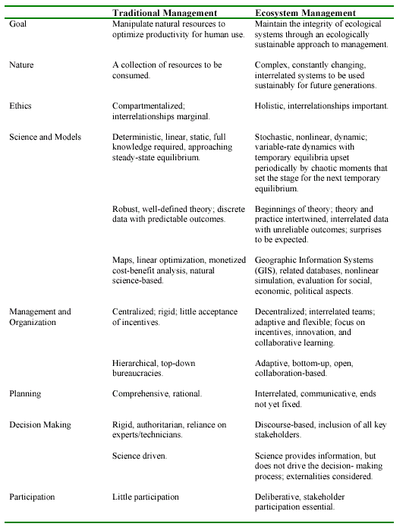

Slide 8
Major Themes of Ecosystem Planning & Management
Focused on maintaining ecosystem integrity via protection of critical habitats
Incorporation of human values
Inter-organizational Coordination
Collaboration of multiple stakeholders
Implementation of plans and planning tools

Slide 9
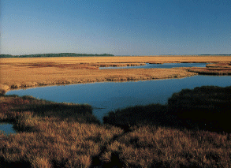
Chesapeake Bay Case Study

Slide 10
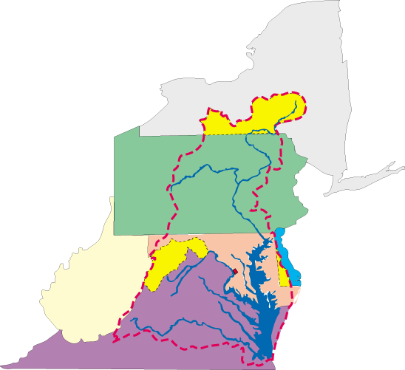
Chesapeake Bay Watershed
New York
Pennsylvania
Maryland
West Virginia
Delaware
District of Columbia
Virginia
Notes:
largest estuary in north america
90% of fresh water comes from 5 major rivers
64,000 sq mile watershed covering 6 states.
3,600 plant and animal species
15 million people in watershed.
Part one. The Chesapeake Bay is an estuary, where fresh and salt water mix. It is a very fertile place for things that grow.
About half of the water volume in the Bay is salt water from the Atlantic Ocean. The other half drains into the Bay from an enormous 64,000 square mile drainage basin or watershed.
Ninety percent of this fresh water is delivered from five major rivers: the Susquehanna (which is responsible for about 50% just by itself), the Potomac, the James, the Rappahannock and the York.
The Bay's watershed includes parts of six states: Delaware, Maryland, New York, Pennsylvania, Virginia and West Virginia, as well as the entire District of Columbia.
Additional information:
-The Chesapeake is the largest estuary in North America.
-More than 3,600 different species of plants and animals live in the tidal waters of the Bay.
-The landscape which comprises the Bay watershed is made up of many interconnected basins, or watersheds. Within each watershed, all water runs to the lowest point - a stream, river or the Bay. On its way, water travels over the surface and across farm fields, forest land, suburban lawns, and city streets, or it seeps into the soil and travels as ground water. Large watersheds like the Chesapeake Bay are made up of many smaller watersheds across several states.

Slide 11
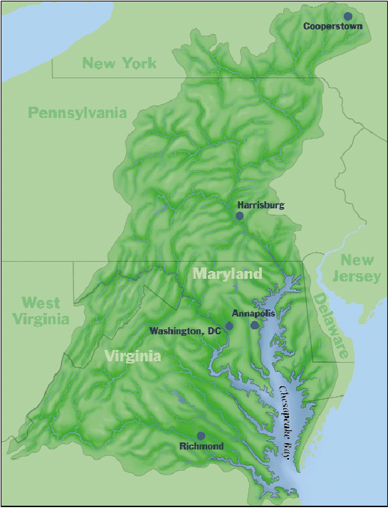

Slide 12
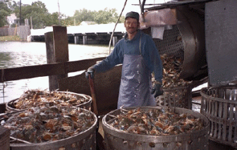
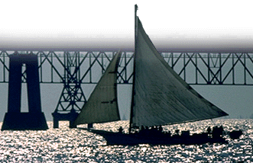
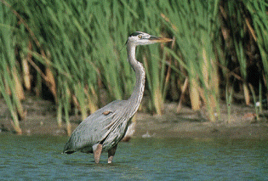
Value of the Bay

Slide 13
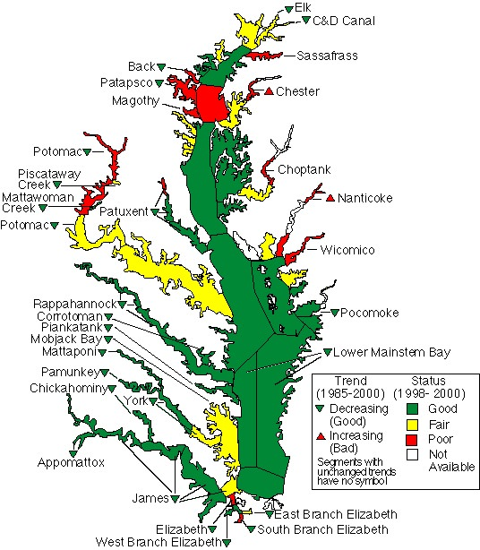
Status and Trends in Nitrogen Concentrations in the Bay and its Tidal Rivers
Notes:
Scientists monitor similar information for nitrogen concentrations.
In some areas nitrogen concentrations are increasing.
In some areas the conditions are only fair or poor.
Remember, excessive concentrations of nitrogen and phosphorus can lead to harmful algal blooms.
Additional information:
-Trends show improvements in many areas, some for the first time with addition of year 2000 data: the lower Pocomoke River, eastern lower Bay, and Piscataway and Mattawoman creeks.
-Only two areas show degrading trends: the Nanticoke and, for the first time, the Chester River.
-Except for the lower Potomac, which dropped from good to fair, the status of other areas is unchanged compared to 1997-1999.
-Status and trends are for surface waters only.
-Trends are not flow-adjusted and, therefore, reflect observed conditions.

Slide 14
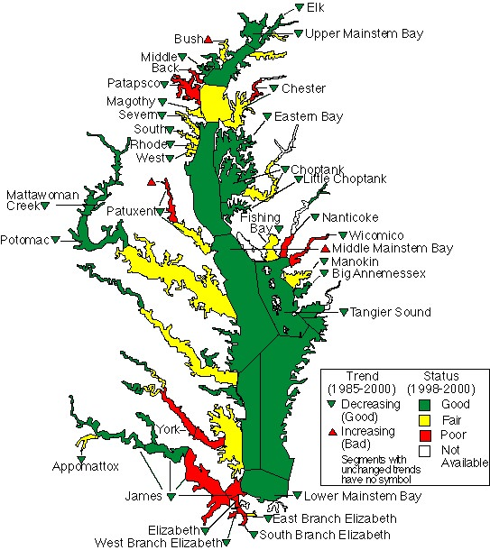
Status and Trends in Phosphorus Concentrations in the Bay and its Tidal Rivers
Notes:
Scientists monitor the Bay and its tidal rivers to keep track of the amount of nutrient pollution in the water. They look at the existing concentrations and also determine whether the concentrations have been increasing or decreasing.
In some areas phosphorus concentrations are increasing.
In some areas the conditions are fair or poor. This means that the concentrations in those areas are higher than they should be.
Additional information:
-Trends show improvements in many areas, some for the first time with addition of year 2000 data: the Elk, Nanticoke and Manokin, and the upper Potomac rivers. Improving trends were lost in the Rappahannock, lower York, Corrotoman and Mattaponi.
-Degrading trends are shown in the Bush River, west branch of the Patuxent, and in the middle mainstem Bay. Fewer areas have good status assessments compared to 1997-1999.
-Status and trends are for surface waters only.
-Trends are not flow-adjusted and, therefore, reflect observed conditions.

Slide 15

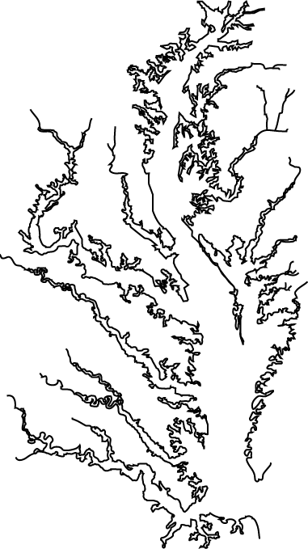
Sources of Pollutants to the Bay
Nonpoint Sources
Run-off from farmland
Run-off from lawns and paved areas
Point Sources
Industry
Wastewater Treatment Plants
Notes:
All pollutants, including nutrient pollution, seep into the groundwater or run off the land when it rains, and enter streams, rivers and the Bay from both nonpoint sources and point sources.
Nonpoint sources deliver nutrients to the rivers and the Bay from broad areas of the watershed, rather than from one specific point. For example, stormwater runs off the land and carries with it pollution from both agricultural and developed lands.
A point source is a specific location or point of entry, like a pipe, where pollutants enter the waterways. Industrial sites and wastewater treatment plants are examples of point sources.
Pollutants also enter the air, from both point and nonpoint sources, and then fall onto the land when it rains. Major sources of pollutants entering the air include automobiles as well as power plants that generate electricity by burning fossil fuels, such as coal and oil.

Slide 16
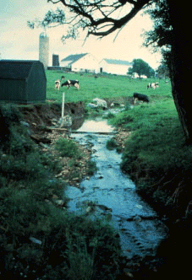
Stormwater and groundwater carry nutrients into rivers and the Bay from a variety of nonpoint sources.
Notes:
Stormwater and groundwater carry nutrients into rivers and the Bay from a variety of nonpoint sources.
Animal waste or fertilizers applied to farm fields can wash off the land into streams and rivers.
Nutrients can also enter stormwater after people have applied excess amounts of fertilizer to their lawns and gardens.
However, scientists believe that agricultural sources contribute the largest portion of the nutrient pollution entering the Bay.
Additional information:
-Many farms have adopted best management practices to reduce nutrient pollution entering the rivers and the Bay.

Slide 17
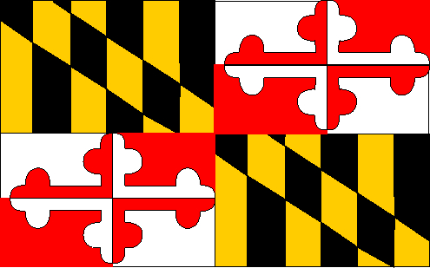
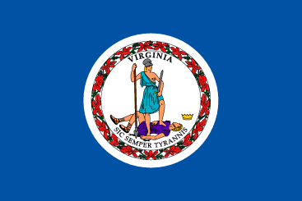
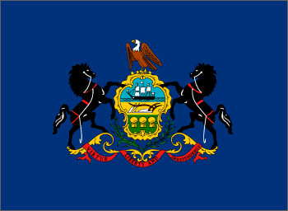

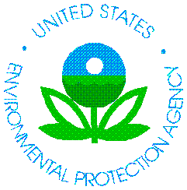
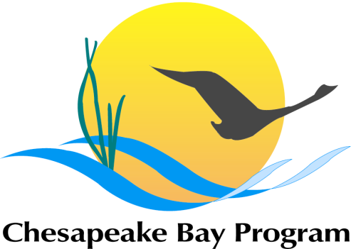
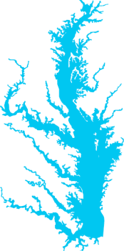
The Chesapeake Bay Program Partnership
Governor of MD
Governor of VA
Governor of PA
Mayor of DC
EPA Administrator
Executive Council
Chair of Chesapeake Bay Commission
Notes:
The Bay is doing better, in part, because of the efforts of a unique partnership - the Chesapeake Bay Program - established in 1983 by the historic Chesapeake Bay Agreement.
Through this partnership, federal, state and local governments, citizens and scientists are working together to restore the Bay.
Additional information:
-Since its inception, the Bay Program's highest priority has been the restoration of the Bay's living resources -- its finfish, shellfish, Bay grasses, and other aquatic life and wildlife.
-The Bay Program is the cooperative partnership among Maryland, Virginia, and Pennsylvania; the District of Columbia; the Chesapeake Bay Commission, a tri-state legislative body; the US Environmental Protection Agency, representing the federal government; and participating citizen advisory groups.
-The Chesapeake Executive Council, made up of the governors of Maryland, Pennsylvania and Virginia; the mayor of Washington DC; the EPA administrator; and the chair of the Chesapeake Bay Commission, guide the restoration by adopting specific Agreements, Directives, Management Plans, etc. These documents contain goals, objectives, recommendations and/or guidelines that are used by the Bay Program partners as guidance in the overall restoration effort.
-Maryland, Pennsylvania, Virginia and the District of Columbia are commonly referred to as the "Bay Agreement States" or "jurisdictions" since they are signatories of the Chesapeake Bay Agreement.
-Delaware, New York and West Virginia, although included in the Bay watershed, are not signatories to the Chesapeake Bay Agreement. Even though they are not formal partners, they are involved in several programs that support Bay restoration efforts.

Slide 18
Bay Cleanup Has Citizen Involvement
CHESAPEAKE
BAY PROGRAM
Scientific and Technical Advisory Committee
Citizen Advisory Committee
representing the interests of: Business, Industry, Environment, Agriculture, Fisheries, Local Governments, Developers, etc.
ALLIANCE FOR THE CHESAPEAKE BAY
CHESAPEAKE
BAY
FOUNDATION
CHESAPEAKE
BAY
CLEANUP
WATERSHED ORGANIZATIONS
LAND TRUSTS
CONSERVATION GROUPS
Notes:
Several citizen groups participate in the Bay Program through their membership with the Citizens Advisory Committee, the Scientific and Technical Advisory Committee and the Local Government Advisory Committee. Members of the Citizens Advisory Committee represent a wide range of interests including those of industry and environmental groups, as well the interests of farmers and watermen.
These groups also work independently to involve citizens and to help promote preservation and restoration of the Bay, its rivers, its watershed and its living resources.

Slide 19
Goal:
40% Reduction in Nutrient Pollution by the Year 2000
Notes:
In 1987, the Chesapeake Bay Agreement was strengthened and focused the difficult restoration challenge into specific goals and commitments. One of these was to reduce nitrogen and phosphorus loads by 40%, from 1985 levels, by the year 2000.
Strategies were developed to meet this goal. One strategy involves implementing biological nutrient removal technology at wastewater treatment facilities. As a result, significant reductions in nitrogen pollution have already been achieved, with even more expected in the future.
Additional information:
-In 1998, 43 major wastewater treatment facilities were using biological nutrient removal (BNR) technology. Commitments have been made that will bring the total up to 74 facilities by the year 2000 and 97 within a few years after 2000. When this happens 63% of the wastewater from major facilities will be treated using BNR and this will result in significant declines in the amount of nitrogen pollution reaching the Bay.
-The 1987 Chesapeake Bay Agreement included a water quality commitment to reduce "controllable" loads of phosphorus and nitrogen by 40%, from 1985 levels, by the year 2000.
-In 1992, Bay Program partners agreed to maintain these reduced loads beyond the year 2000.
-"Controllable sources" are human induced sources from Maryland, Pennsylvania, Virginia and the District of Columbia.

Slide 20
Nutrient Pollution Declining, but We Still Need to Do More
Total Nutrient Loads Delivered to the Bay from All Bay Tributaries (MD, PA, VA, DC).
Phosphorus
Nitrogen
Maintaining reduced nutrient loads will be a challenge due to expected population growth in the region.
New goals will be established soon for additional reductions of nutrients, as well as sediment, to be achieved by 2010.
Phosphorus
Goal
Nitrogen
Goal
Source: Chesapeake Bay Program Phase 4.3 Watershed Model.
Data include total nutrient loads delivered to the Bay, from point and nonpoint sources, from Chesapeake Bay Agreement jurisdictions : MD, PA, VA and DC.
Notes:
Nutrient pollution is declining but we still need to do more to reach our goals.
Maintaining reduced nutrient loads will be a challenge due to expected population growth in the region.
Additional information:
-Chesapeake Bay Program partners are committed to reducing loads of nutrients and maintaining those reduced levels.
-Throughout the 1990s, progress was made. A recent analysis* of nutrient reduction programs implemented in MD, PA, VA and DC revealed that between 1985 and 2000, phosphorus loads delivered to the Bay from all of its tributaries declined 8.1 million pounds per year. Nitrogen loads declined 52 million pounds per year.
-Unfortunately, Baywide phosphorus reductions fell 1.29 million pounds per year short of the 2000 goal, while nitrogen loads fell 21.4 million pounds per year shy as well. In areas where excessive nutrient loads most adversely affect the Bay, the Potomac River and points north, phosphorus goals were met. Nitrogen goals for those areas are expected to be met once tributary strategies are fully implemented in 2003.
-Excess nutrients are a problem because they nourish algal blooms which cloud the water, deprive underwater Bay grasses of sunlight, and rob the water of oxygen needed by Bay creatures.
* Computer modeling is used at the Bay Program to simulate estimated nutrient pollution loads that would be delivered to Bay waters under various conditions. Data and information collected through the Bay Program's monitoring network are provided as inputs to the model. Additional information from Bay partners' tributary strategies are provided as inputs. Using the vast amount of information that is provided as the input to the model, the model can be used to estimate loads of nutrients that would be delivered to the Bay during different years, or under various conditions (such as different degrees of management actions).

Slide 21
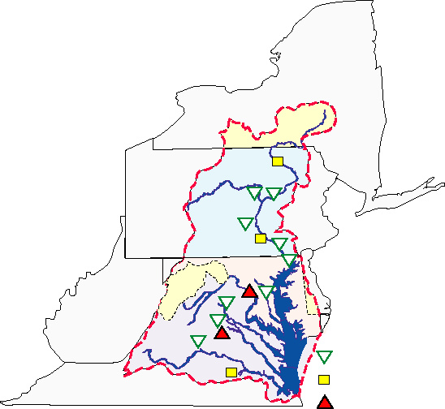
Phosphorus Levels Declining in Non-tidal Portions of the Rivers
Monitoring data from major rivers entering tidal waters of Chesapeake Bay show that phosphorus concentrations are decreasing in portions of the Susquehanna River, in the Patuxent, Rappahannock and James rivers and in the Mattaponi (a tributary to the York).
The Potomac River and the and Pamunkey (a tributary to the York) show increasing trends.
Portions of the Susquehanna and the Appomattox (a tributary to the James) show no trend.
1980s – 2000
Decreasing
No significant trend
Increasing
Notes:
Monitoring data from major rivers entering tidal waters of the Bay show that phosphorus levels are declining in many of the non-tidal portions of the rivers.
These results are encouraging because they are a measure of the success of point and nonpoint source management programs being implemented throughout the Bay watershed.
Additional information:
Phosphorus concentrations (TP) are monitored near the head of tide (fall line) in eight of the Bay's major rivers, and in the non-tidal portion of the Susquehanna River in Pennsylvania. These flow adjusted concentration trends are independent of annual variability in stream flow and allow us to evaluate the success of point and nonpoint source management programs on a watershed-wide scale.
Results are shown for trend analyses using the earliest complete data set collected since 1985.
Starting at monitoring sites at the top of the map and moving left to right:
Towanda (on Susquehanna R.), no significant trend in TP concentrations from 1/89 through 12/00.
Lewisburg (on West Branch of Susquehanna R.), decreasing trend in TP concentrations from 1/85 through 12/00.
Danville (on Susquehanna R.), decreasing trend in TP concentrations from 1/85 through 12/00.
Newport (on Juniata R.), decreasing trend in TP concentrations from 1/85 through 12/00.
Marietta (on Susquehanna R.), no significant trend in TP concentrations from 1/87 through 12/00.
Conestoga (on Conestoga R.), decreasing trend in TP concentrations from 1/85 through 12/00.
Conowingo (on Susquehanna R.), decreasing trend in TP concentrations from 1/85 through 12/00.
Potomac (on Potomac R.), increasing trend in TP concentrations from 1/85 through 12/00.
Patuxent (on Patuxent R.), decreasing trend in TP concentrations from 1/85 through 12/00.
Rappahannock (on Rappahannock R.), decreasing trend in TP concentrations from 7/88 through 12/00.
Mattaponi (on Mattaponi R., tributary to York R.), decreasing trend in TP concentrations from 10/89 through 12/00.
Pamunkey (on Pamunkey R., tributary to York R.), increasing trend in TP concentrations from 7/89 through 12/00.
James (on James R.), decreasing trend in TP concentrations from 7/88 through 12/00.
Appomattox (on Appomattox R., tributary to James R.), no significant trend in TP concentrations from 7/89 through 12/00.
For more information contact Marcia Olson at CBPO (1-800-968-7229). Data provided by USGS (Scott Phillips 410-238-4252) and Susquehanna River Basin Commission (Bob Edwards 717-238-0425).

Slide 22
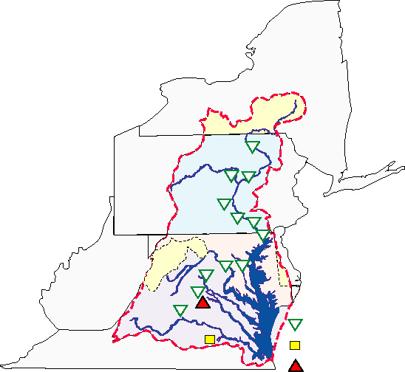
Nitrogen Levels Declining in Non-tidal Portions of the Rivers
Monitoring data from major rivers entering tidal waters of Chesapeake Bay show that nitrogen concentrations are decreasing in the Susquehanna, Potomac, Patuxent, Rappahannock, Mattaponi (a tributary to the York), and James rivers.
The Pamunkey (a tributary to the York) shows an increasing trend.
The Appomattox (a tributary to the James) shows no trend.
1980s – 2000
Decreasing
No significant trend
Increasing
Notes:
Monitoring data from major rivers entering tidal waters of the Bay show that nitrogen levels are declining in many of the non-tidal portions of the rivers.
Although we are not necessarily seeing these same trends throughout tidal portions of the rivers and in the Bay, it is hoped that these "upstream" improvements will eventually show up "downstream".
Additional information:
Nitrogen concentrations (TN) are monitored near the head of tide (fall line) in eight of the Bay's major rivers, and in the non-tidal portion of the Susquehanna River in Pennsylvania. These flow adjusted concentration trends are independent of annual variability in stream flow and allow us to evaluate the success of point and nonpoint source management programs on a watershed-wide scale.
Results are shown for trend analyses using the earliest complete data set collected since 1985.
Starting at monitoring sites at the top of the map and moving left to right:
Towanda (on Susquehanna R.), decreasing trend in TN concentrations from 1/89 through 12/00.
Lewisburg (on West Branch of Susquehanna R.), decreasing trend in TN concentrations from 1/85 through 12/00.
Danville (on Susquehanna R.), decreasing trend in TN concentrations from 1/85 through 12/00.
Newport (on Juniata R.), decreasing trend in TN concentrations from 1/85 through 12/00.
Marietta (on Susquehanna R.), decreasing trend in TN concentrations from 1/87 through 12/00.
Conestoga (on Conestoga R.), decreasing trend in TN concentrations from 1/85 through 12/00.
Conowingo (on Susquehanna R.), decreasing trend in TN concentrations from 1/85 through 12/00.
Potomac (on Potomac R.), decreasing trend in TN concentrations from 1/85 through 12/00.
Patuxent (on Patuxent R.), decreasing trend in TN concentrations from 1/85 through 12/00.
Rappahannock (on Rappahannock R.), decreasing trend in TN concentrations from 7/88 through 12/00.
Mattaponi (on Mattaponi R., tributary to York R.), decreasing trend in TN concentrations from 10/89 through 12/00.
Pamunkey (on Pamunkey R., tributary to York R.), increasing trend in TN concentrations from 7/89 through 12/00.
James (on James R.), decreasing trend in TN concentrations from 7/88 through 12/00.
Appomattox (on Appomattox R., tributary to James R.), no significant trend in TN concentrations from 7/89 through 12/00.
For more information contact Marcia Olson at CBPO (1-800-968-7229). Data provided by USGS (Scott Phillips 410-238-4252) and Susquehanna River Basin Commission (Bob Edwards 717-238-0425).

Slide 23
Forest Acreage Declining
Forests provide critical habitat and help prevent pollutants and sediment from reaching the Bay and rivers.
About 59% of the Bay basin is currently forested.
The forest that regrew from the 19th to the mid-20th centuries is steadily declining. Current losses represent permanent conversions.
Notes:
Forests provide critical habitat for many creatures that live in the watershed.
They also help prevent pollutants from reaching the Bay and rivers.
Forest once covered about 90-95% of the Bay's watershed. About 59% of the Bay basin is currently forested.
The forest land that regrew from the 19th to the mid-20th centuries is steadily declining. Current losses represent permanent conversions.
Additional information:
-The graph shows the percentage of forest cover in the basin during particular times since 1650. Between 1650 and today, nearly all of the forest land in the basin has been cut at one time or another. Isolated remnants of "virgin" forest (never cut) exist in very small quantities.
-From 1750-1890, most of the land was cleared for farming, timber and fuel. In the last 20 years, most deforestation has been due to urban/suburban sprawl and some agricultural conversion.
-Forests contribute to the Bay's health in a variety of ways:
Filter nutrients and sediment
Capture rainfall and regulate streamflow
Moderate stream and air temperatures
Stabilize erodible soils
Create and maintain fish and wildlife habitat
Preserve biodiversity

Slide 24

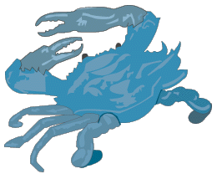
Wetland Loss Continues
In the 1980s we were still losing
estuarine wetlands, like tidal marshes,
but loss rates were significantly reduced.
Loss rates were down from
547 acres/year during the 1950s - 1970s,
to 5 acres/year during the 1980s.
However, freshwater wetlands, like forested swamps, were lost at an increasing rate.
Loss rates were up from
2,373 acres/year during the 1950s - 1970s,
to 2,807 acres/year during the 1980s.
Notes:
In the 1980s, we were still losing estuarine wetlands, like tidal marshes, but loss rates were significantly reduced compared to the losses in the 1950s through 1970s.
However, freshwater wetlands, like forested swamps, were being lost at an increasing rate.
Additional information:
-Baywide surveys have not yet been completed for determining Baywide status and trends in the 1990s; however, work is being done and we hope to have an update completed within the next couple of years.
-Wetlands are accorded a certain degree of protection. Federal and state governments regulate development activities such as dredging and filling in wetlands. Despite these controls, wetlands, like other natural areas, remain under increasing pressure for development as our population increases.
-Based on data collected by the U.S. Fish and Wildlife service, the Bay's watershed lost about 2.5 percent of its wetlands between 1982 and 1989.
- Most of the wetlands in the Bay watershed are freshwater (1.3 millions acres) with only 200,000 acres of estuarine wetlands.
-Estuarine wetlands include all salt and brackish tidally influenced wetlands, but do not include those found in the tidal freshwater reaches of the Bay.
-Estuarine emergent wetlands, commonly called tidal marshes, are the most common type of estuarine wetlands. They are tidally influenced by salt water and are found along the shores of the Chesapeake Bay. The causes for loss of this wetland type are sea level rise (38%), development (32%), agricultural practices (24%), and pond creation (6%).
-Forested wetlands are the most common type of freshwater wetland. Freshwater forested wetlands are found on floodplains along the freshwater tidal and non-tidal portions of rivers and streams. The causes for loss of this wetland type are reservoir creation (45%), development (23%), pond creation (18%), and agricultural practices (14%).

Slide 25
Patterns of Land Use and Consumption of Natural Resources Threaten Our Progress
Low density, single-use development, often called sprawl, tends to use "resource lands", such as forests, farms and wetlands.
This impacts the water quality of local waterways and the Bay, as well as the region's economy and heritage.
These development trends also have resulted in people driving farther to reach jobs and services, leading to increases in vehicle miles traveled.
Notes:
The current land use patterns show we are threatening much of the progress that has been made so far in restoring the Bay.
Low density, single-use development, often called sprawl, tends to use up valuable "resource lands", such as forests, farms and wetlands.
Developing these impacts water quality as well as the region's economy and heritage.
These development trends also have caused people to drive farther to reach their jobs, stores and schools. The more we drive, the more we harm the Bay.
Additional information:
-Between 1985 and 1997, 264,000 acres of forest and wetlands and 158,000 acres of farmland were lost in the Bay region.
-Sprawl development patterns require increased impervious surfaces such as roads, parking lots and rooftops.
-In Maryland, land consumption for residential development was double the rate of population growth between the 1970s and 1990.
-Sprawl development densities are often too low to support mass transit. Between 1970 and 1997, vehicle miles traveled increased at four times the rate of population in the Bay region. Pollution from car exhaust harms the Bay.
-Sprawl development densities are often too low to support public sewage treatment. The benefits of new nitrogen reduction technologies scheduled to be or currently being used at public sewer facilities will not be maximized if use of septic systems increases.
-The issue of septic system use and growth is very complex. Septic system use is generally associated with low density development where public sewage treatment is not economically feasible. To reduce the use of septic systems, the Bay Program does not advocate that public sewer lines be extended to low density rural areas. This would only serve to promote increased growth in areas where open space and farmland should be conserved. The Bay Program does advocate that growth should occur in areas where existing public sewage treatment and other forms of infrastructure currently exist.

Slide 26
Summary of Impacts
In sum, the Bay watershed has lost half its forests, 60 percent of its wetlands, almost 90 percent of its underwater grasses, and nearly 98 percent of its oysters.
The result is that we have stripped the Bay of its natural habitats on the land and in the water, as well as stripping it of its ability to filter out pollution.

Slide 27
Bay 2000 Agreement
By 2010, develop and implement locally supported watershed management plans in two-thirds of the Bay watershed covered by this Agreement.
By 2010, achieve a net resource gain by restoring 25,000 acres of tidal and non-tidal wetlands.
By 2002, ensure that measures are in place to meet our riparian forest buffer restoration goal of 2,010 miles by 2010.

Slide 28
Bay 2000 Agreement (Cont.)
By 2010, correct the nutrient- and sediment-related problems sufficiently to remove the Bay and the tidal portions of its tributaries from the list of impaired waters under the Clean Water Act.
Permanently preserve from development 20 percent of the land area in the watershed by 2010.
By 2012, reduce the rate of harmful sprawl development of forest and agricultural land in the Chesapeake Bay watershed by 30 percent.

Slide 29
Acres of Bay Grasses
GOAL: 185,000 acres by 2010.
STATUS: Total acreage in 2003 is estimated to be 64,709.
The decrease appears to be the result of substantial reductions in widgeongrass in the lower and mid-bay regions.
In addition, major declines in freshwater species occurred in the upper portion the Potomac River and Susquehanna region likely due to persistent turbidity resulting from rain occurring throughout the spring and summer that may have contributed to a very early decline, well before Hurricane Isabel affected Chesapeake Bay.
Restoration Goal (185,000 acres by 2010)
*Note – Hatched area of bar includes estimated additional acreage. No survey in 1988.
Source: Chesapeake Bay Program.
Notes:
Hierarchy Level 6 = Changes in Health, Ecology or Other Effects
For 2003, 61,694 acres of SAV were mapped in Chesapeake Bay and its tributaries. However some portions of the Bay were not flown due to adverse weather in the spring and summer and Hurricane Isabel in the fall. These regions, including Tavern and Swan creeks; lower Chester River; upper Wicomico River; Prentice, Dividing, and Ball creeks; Dameron Marsh; and Great Wicomico River were not fully mapped in 2003. These regions had 3,015 acres of SAV in 2002. In order to ensure a valid analysis of change in SAV distribution and abundance given the reduced region mapped in 2003, all direct comparisons to previous years are restricted to only those regions that were mapped in both years.
Significant changes in SAV distribution were measured 2002-2003. SAV decreased 30% (26,134 ac) in the regions mapped for both years. The area mapped in 2003 represents 35% of the portion of the 2010 Restoration goal (set by the Chesapeake Executive Council in Directive 93-3, revised in 2003) adjusted to only include these mapped regions (173,043 ac).
The significant changes in SAV distribution in 2003 appear to be the result of substantial reductions in widgeongrass populations in the lower and mid-bay regions, notably the Rappahannock River and the region from Tangier Island to Eastern Bay. For example, 63% of the loss of SAV in the lower bay zone occurred in the Rappahannock area where widgeongrass was most abundant previously. In addition to these large declines in widgeongrass, major declines in freshwater SAV species occurred in the upper portion the Potomac River and Susquehanna region. While populations of SAV appeared to be present in these segments very early in the growing season, the persistent turbidity resulting from rain occurring throughout the spring and summer may have contributed to a very early decline, well before Hurricane Isabel affected Chesapeake Bay.
Bay grasses, or submerged aquatic vegetation (SAV), are important to the complex Chesapeake Bay ecosystem because they produce oxygen, supply food for many species (especially waterfowl), offer shelter and nursery habitat for fish and shellfish, reduce wave action and shoreline erosion, absorb excess nutrients such as nitrogen and phosphorus, and trap sediments.
Increasing quantities of nutrients, such as phosphorus and nitrogen, as well sediment in the water – some still due to significant runoff from Tropical Storm Agnes in 1972 – have choked or eliminated the growth of SAV in in many areas, and contributed to declines in SAV acreage throughout the Bay. By 1984, aerial surveys of bay grasses documented only about 38,000 acres in the Bay and its tributaries.
Bay grasses are a unique yardstick for measuring the progress of Chesapeake Bay restoration efforts, because they are not under harvest pressure and their health is closely linked to water quality. Increases in Bay grasses are expected in areas where water quality conditions are improving.
In 1993 the Chesapeake Bay Program (CBP) agreed to work to restore SAV to its historical levels. They set an interim restoration goal of 114,000 acres - the total area vegetated at one time or another since the early 1970s. Based on rates of recovery at that time, the goal was expected to be achieved by 2005.
In the Chesapeake 2000 agreement, the CBP recommitted to the existing goal of protecting and restoring 114,000 acres of SAV. They also agreed to “revise SAV restoration goals and strategies to reflect historic abundance, measured as acreage and density from the 1930s to the present. The revised goals will include specific levels of water clarity which are to be met in 2010. Strategies to achieve these goals will address water clarity, water quality, and bottom disturbance.”
In 2003, the CBP adopted the Strategy to Accelerate the Protection and Restoration of Submerged Aquatic Vegetation in the Chesapeake Bay including a new Baywide restoration goal of 185,000 acres by 2010. This acreage represents approximate historic abundance from the 1930s to present. Scientists believe increasing bay grass coverage beyond today’s acreages will result in dramatic improvements throughout the entire Bay ecosystem.
The aerial survey is flown from late spring to early fall, the photography is processed in the fall and winter, and preliminary area totals are usually available the following spring.
For additional information, contact Mike Fritz at CBPO (1-800-968-7229, ext. 721).

Slide 30
Wetlands Protection, Restoration, and Enhancement
Wetlands Restoration Program Achievement
GOAL: Achieve a net resource gain by restoring 25,000 acres by 2010 in the Wetlands Restoration Program.
In addition, the states’ regulatory programs will achieve a No-net loss of wetlands.
STATUS: Since 1998, 14,317 acres were restored. In order to achieve the goal, 10,683 additional acres need to be restored by 2010.
During this time, an additional 1,312 acres were gained in the regulatory programs.
PA Goal: 4,000 acres
Restored: 930 acres
Percent Achievement: 23%
MD Goal: 15,000 acres
Restored: 12,593 acres
Percent Achievement: 84%
Total
Remaining
43%
Total
Restored
57%
VA Goal: 6,000 acres
Restored: 794 acres
Percent Achievement: 13%
Source: Chesapeake Bay Program. Regulatory Program data: MD, 1998-2003; PA ,1998-2002; VA, 2000-2003. Restoration Program data: MD, 1998-2003 (2003 partial); PA, 1998-2001; VA 2001-2003 (2002-2003 partial). Restoration totals include: restoration, enhancement, and creation of tidal and non-tidal wetlands in the Wetlands Restoration Program
Notes:
Hierarchy Level 6 = Changes in Health, Ecology or Other Effects
In 2000, the Chesapeake Bay Program partners committed to “achieve a no-net loss of existing wetlands acreage and function in the signatories’ regulatory programs.” They also committed to “by 2010, achieve a net resource gain by restoring 25,000 acres of tidal and non-tidal wetlands. To do this, we commit to achieve and maintain an average restoration rate of 2,500 acres per year basin wide by 2005 and beyond. We will evaluate our success in 2005.”
Restoration totals include: restoration, enhancement, and creation of tidal and non-tidal wetlands in the Wetlands Restoration Program.
Since 1998, 14,317 acres were restored. In MD, 12,593 acres were restored between 1998 and 2003 (2003 data are partial). In PA, 930 acres were restored between 1998 and 2001. In VA, 794 acres were restored in 2001-2003 (2002 and 2003 data are partial).
Since 1998, there was no net loss in the regulatory programs, in fact, 1,312 acres were gained. In MD, 391 acres were gained between 1998 and 2003. In PA, 289 acres were gained between 1998 and 2002. In VA, 632 acres were gained between 2000 and 2003.
One of the most important functions of wetlands is that they help restore and maintain water quality in our nation's rivers and streams. Wetlands are capable of minimizing sediment loads and absorbing pollutants such as nitrogen and phosphorus. They also help to recharge aquifers.
Wetlands often have been referred to as natural sponges that absorb flooding waters. They help protect adjacent and downstream properties by temporarily storing floodwaters. Often located between rivers and upland areas, they serve to buffer the land against erosion by binding soil with the roots of wetland plants.
Wetlands provide particularly crucial habitat for fishes, shellfish, waterfowl, shorebirds, wading birds and several mammals. Striped bass, menhaden, flounder, oysters and blue crabs are among the most commercially important fish and shellfish that depend on estuarine wetlands. Palustrine wetlands also provide valuable aquatic habitat and support a variety birdlife including ducks, geese and a large number of songbirds.
Many recreational activities occur in and around wetlands, including waterfowl hunting, fishing, crabbing, hiking, birdwatching, photography, swimming and boating.
Notes: 1) VA 2001 Data is not a comprehensive representation of all organizations who may be undertaking restoration in Virginia. Year 2001 data does not discriminate between restoration (hydric soils) and creation (non-hydric soils). Forested restoration in VA is under-reported due to lack of adequate discrimination between restored wetland types. 2) VA 2002-2003 data represents the best current available data in Virginia from voluntary restoration efforts; data do not include restoration efforts under federal funds such as CREP and Farm Bill reported by NRCS and DCR (7/12/04). The data will be added as they are finalized.
For additional information on State Restoration Programs please go to:
Maryland: Department of the Environment www.mde.state.md.us/Programs/WaterPrograms/Wetlands_Waterways/about_wetlands/restoration.asp
Virginia: Department of Environmental Quality www.deq.virginia.gov/wetlands
Pennsylvania: Department of Environmental Protection www.dep.state.pa.us/dep/deputate/watermgt/wc/subjects/wwec/general/wetlands/wetlands.htm
For additional information, contact Mike Fritz at CBPO (1-800-968-7229, ext. 721).

Slide 31
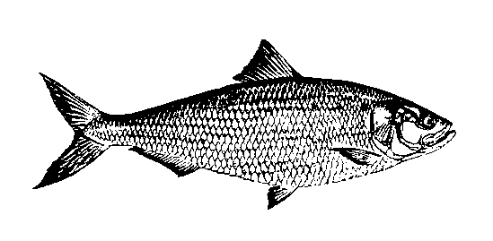


Stream Miles Opened to Migratory Fish
GOAL: To restore access to historical spawning grounds for migratory fish.
STATUS: The removal of stream blockages and construction of fish passages in 2004 reopened 352 miles of historic spawning habitat to migratory fish.
Total miles made available to migratory fish since 1988 is 1,570. The 1,357 mile goal has been achieved. An additional 238 miles have been made available to resident fish.
2003 Goal (1,357 miles)
1998 Goal (731 miles)
Source: Chesapeake Bay Program Office
Notes:
Hierarchy Level: 4 = Changes in Ambient Conditions
More than a thousand miles of fish spawning habitat on Chesapeake Bay tributaries are currently blocked by dams, culverts and other obstructions. Fish, like shad, that live in the Bay and ocean as adults and migrate to spawn in freshwater are called anadromous fish. Fish passages help these fish swim upstream, past dams and other blockages, to reach freshwater spawning habitat.
Restoring and protecting the Bay's vital fishery resources are key parts of the 1987 Chesapeake Bay Agreement and the more recent agreement, Chesapeake 2000. Working toward this restoration goal, the Chesapeake Bay Program partners have committed to removing blockages and reopening 1,357 miles of the Bay's tributaries for migratory fish by the year 2003. In Chesapeake 2000, the partners also committed to set a new goal, by 2002, with implementation schedules for additional migratory and resident fish passages that address the the removal of physical blockages. In addition, the goal will address the removal of chemical blockages caused by acid mine drainage. The new goal will be announced in January 2005.
The removal (and/or natural destruction) of stream blockages and the construction of fish passages in 2004 reopened 352.5 new miles of historic spawning habitat to migratory fish. Between 1988 and 2004 a cumulative total of 1,569.7 miles became available to migratory fish, and an additional 237.74 miles to resident fish. The 237.74 miles currently open only to resident fish will eventually be open to migratory fish as well.
Anadromous fish, such as shad and river herring, rely on access to freshwater streams with suitable bottom and current for spawning.
Blockage of these streams, habitat degradation and heavy fishing pressure have resulted in dramatic declines of these fish.
Early removals of blockages, along with harvest restrictions, have resulted in increased numbers of migratory fish in the Bay and its tributaries.
Although some stream miles were opened before 1988-1989, we begin our graph with these years because this is when the Bay Agreement focused on opening stream miles as part of the restoration process.
For more information, contact Mike Fritz at CBPO (1-800-968-7229, ext. 721).

Slide 32
Trends in Finfish: Striped Bass
Maryland
Moratorium
1985 - 1990
GOAL: Sustain the fishery.
STATUS: Moratoriums in Maryland and Virginia followed by conservative harvest limits allowed the stock to rebound. The stock was declared restored in January 1995 by the Atlantic States Marine Fisheries Commission.
Note: Differences in data treatment by MD and VA mean these graphs are not directly comparable.
Virginia
Moratorium
1989 - 1990
Source for Maryland index data: Maryland Department of Natural Resources.
Source for Virginia index data: Virginia Institute of Marine Sciences.
Notes:
Hierarchy Level 6 = Changes in Health, Ecology or Other Effects
Striped bass have formed the basis of one of the most important commercial and recreational fisheries on the Atlantic coast.
Striped bass are anadromous fish - they spend much of their life in the ocean and return to the Chesapeake's tributaries to spawn.
A major factor in the striped bass decline was overharvesting, which disrupted the balance of the spawning stock. Other factors included contaminants in spawning grounds and loss of habitat.
The 1979 Emergency Striped Bass Research Study resulted in the Atlantic States Marine Fisheries Commission (ASMFC) preparing a coastwide management plan severely restricting harvests. In 1984, Congress authorized a forced moratorium for states found out of compliance with the ASMFC plan. Maryland and Delaware self-imposed moratoria in 1985, and Virginia and the Potomac River Fisheries Commission followed suit in 1989. Limited seasons resumed in 1990.
In 1989 the Bay Program developed a Striped Bass Fisheries Management Plan to implement specific Chesapeake Bay management measures.
In January 1995 the ASMFC declared the stock restored.
The striped bass success story is due to interagency cooperation and management at the federal and state levels.
For more information, contact Mike Fritz at CBPO (1-800-968-7229, ext. 721) or Derek Orner at NOAA (1-800-968-7229, ext. 676).

Slide 33
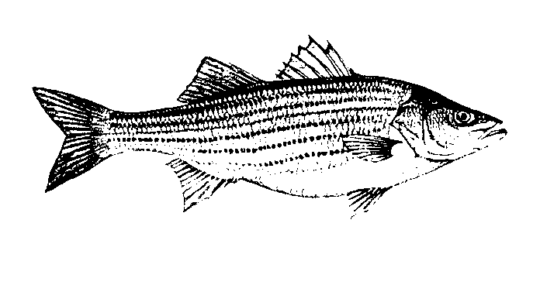
Striped Bass Spawning Stock
Baywide Female Spawning Stock Biomass
GOAL: The goal for a recovered fishery was a spawning stock biomass (SSB) equal to the average SSBs recorded during 1960 - 1972.
STATUS: Successful management measures led to decreased harvest pressure. The Atlantic States Marine Fisheries Commission declared the stock restored as of
January 1, 1995.
Fishing moratoria:
MD & DE: 1985-1990
VA: 1989-1990
Source: Advisory and Summary Reports on the Status of the Atlantic Striped Bass,
Atlantic States Marine Fisheries Striped Bass Technical Committee
Notes:
Hierarchy Level 6 = Changes in Health, Ecology or Other Effects
Striped bass have formed the basis of one of the most important fisheries (commercial and recreational) on the Atlantic coast.
Striped bass are anadromous fish - they spend much of their life in the ocean and return to the Chesapeake's tributaries to spawn.
A major factor in the striped bass decline was overharvesting, which disrupted the balance of the spawning stock. Other factors included contaminants in spawning grounds and loss of habitat.
The 1979 Emergency Striped Bass Research Study resulted in the Atlantic States Marine Fisheries Commission (ASMFC) preparing a coastwide management plan severely restricting harvests. In 1984 congress authorized a forced moratorium for states found out of compliance with the ASMFC plan. Maryland and Delaware self imposed moratoria in 1985, and Virginia and the Potomac River Fisheries Commission followed suit in 1989. Limited harvest seasons resumed in 1990.
In 1989 the Bay Program established a Striped Bass Fisheries Management Plan with a goal of controlling harvest while continuing to rebuild stocks.
In January 1995 the ASMFC declared the stock restored.
The striped bass success story is due to interagency cooperation and management at the federal and state levels.
For more information, contact Mike Fritz at CBPO (1-800-968-7229, ext. 721) or Derek Orner at NOAA (1-800-968-7229, ext. 676).

Slide 34

American Shad: Population Trends
GOAL: Restore shad populations in the upper Chesapeake Bay.
STATUS: Stocking efforts, a moratorium on shad fishing, and fish passage development on the Susquehanna River have helped to increase the number of shad returning to Conowingo Dam from several hundred per year in the early 1980s to an average 114,165 per year in 2002-2004.
In 2004, 109,360 shad returned. In spite of these improvements, Susquehanna populations are far below the restoration program goal of 2 million fish.
Source: PA Fish and Boat Commission
Notes:
Hierarchy Level 6 = Changes in Health, Ecology or Other Effects
2004 was an average year, slightly less than 2003 but more than 2002. The three year floating average has declined, likely due to higher than average springtime river flows for3 years, and this year, rapidly warming temperatures which ended the run early.
Permanent fish passage was developed at Conowingo Dam, MD in 1991. This prompted a settlement agreement with three upstream dam owners which led to construction of fish passages at Holtwood and Safe Harbor dams in 1997 and York Haven Dam in 2000.
Shad stocks are managed under an amendment to an interstate plan developed by the Atlantic States Marine Fisheries Commission (ASMFC) in 1998. ASMFC requires states to control inland fisheries and phase out ocean shad fisheries by 2005.
The Chesapeake Bay Program developed an Alosid Baywide Fisheries Management Plan (for shad, river herring and alewife) in 1989 with the goals of protecting, restoring, and enhancing Baywide stocks. The Chesapeake Bay Program plan will be revised and target population sizes are to be established by the end of 2002.
Through fish passage, habitat restoration, restocking and effective management, researchers and managers hope to restore a commercially, recreationally and biologically important species.
For more information, contact Mike Fritz at CBPO (1-800-968-7229, ext. 721).

Slide 35
Trends in Blue Crab: Commercial Harvest
Chesapeake Bay Blue Crab Landings
GOAL: Manage blue crabs to conserve the Baywide stock, protect its ecological value and optimize the long-term use of the resource.
STATUS: The 2003 harvest of approximately 48 million pounds is below the long term average and near historic lows. The 2003 fishing mortality rate did not exceed the overfishing threshold but is above the target.
2003
Average Fishing Mortality Rate
Threshold: Not to be exceeded
Target: Safe Harvest Level
2003
Sources: Landings - National Marine Fisheries Service, NOAA.. Fishing Mortality Rate - Chesapeake Bay Stock Assessment Committee (CBSAC), unweighted average of 4 surveys.
Notes:
Hierarchy Level 6 = Changes in Health, Ecology or Other Effects
The Chesapeake 2000 Agreement commits the Bay states to "establish harvest targets for the blue crab fishery by 2001." In 2001, Bay jurisdictions met this commitment by adopting a Baywide threshold for the blue crab stock. They agreed to double the spawning stock via a 15 percent reduction in harvest levels (based on 1997-1999 average) over three years.
The average length-based fishing mortality rate as determined from the Maryland and Virginia trawl surveys, the Calvert Cliffs crab pot survey and the Baywide winter dredge survey was 0.83 in 2003. None of the current length-based fishing mortality rates estimated from individual surveys exceeded the threshold fishing mortality rate F = 1.0 and none were below the target level of F = 0.7. While the 10% threshold line represents a danger zone, beyond which the fishery should not be allowed to go, the target represents a goal and level that we do in fact wish to reach. The harvest target is considered a safe harvest level below the threshold line.
The three-year (2001-2003) average, commercial Baywide harvest (50 million pounds) is 32% below the long-term (1968 - 2003) average of about 73 million pounds and is considerably below the prediction bounds. The 2003 Baywide harvest of approximately 48 million pounds is below average and is near the historic lows. For the 1968-2003 period, Baywide commercial harvests exceeded 100 million pounds in 1966, 1981, 1983 and 1993. Based on the historical relationship between winter dredge survey abundance and commercial harvest, we expect the Baywide commercial Chesapeake Bay harvest in 2004 to be at similar levels as in recent years.
NOAA, one of the Bay Program federal agency partners, has sponsored research, through the Chesapeake Bay Stock Assessment Committee (CBSAC), to assess the status of the blue crab stock. An Advisory Report is issued every May. The 2004 report, based on several surveys through 2003, concluded that analysis of long term fishery independent surveys conducted in Chesapeake Bay (Maryland and Virginia trawl surveys, Calvert Cliffs crab pot survey and Baywide winter dredge survey) indicate that during 2003 blue crab abundance showed moderate improvement compared to the near historically low levels of the previous four years. Survey results are not uniform however, and relatively low stock levels continue to create a risk of recruitment failure. The current status of the stock was compared to thresholds and targets endorsed by regional management agencies in January 2001. Stock abundance was above the overfished threshold. Measures of fishing mortality indicate continued high exploitation rates. The winter dredge survey measured fishing mortality below the action threshold level for the first time since 1999. Stock abundance remained below the Bi-State Blue Crab Advisory Committee abundance action threshold. The low abundance combined with a high exploitation rate indicates a stock condition that warrants concern for the seventh consecutive year.
The goal of the Bay Program's 1997 Chesapeake Bay Blue Crab Fishery Management Plan is to manage the Chesapeake Bay blue crabs in a manner which conserves the Baywide stock, protects its ecological value, and optimizes the long-term use of the resource.
For more information, contact Derek Orner at NOAA (1-800-968-7229, ext. 676) or Mike Fritz at CBPO (1-800-968-7229, ext. 721).

Slide 36
Trends in Blue Crab: Mature Females
Spawning Stock Abundance
GOAL: To protect the health of the blue crab stock and maintain the spawning stock at a sustainable level.
STATUS: Mature female abundance has trended upwards for the past three years after hitting an historic low in 2000, but has been below the long-term average for six straight years and ten of the past twelve years.
Average
VIMS Trawl, Calvert Cliffs,
MD Trawl & Winter Dredge
VIMS Trawl &
Calvert Cliffs
VIMS Trawl,
Calvert Cliffs &
MD Trawl
2003
Sources: MD Department of Natural Resources, Virginia Institute of Marine Science, Academy of Natural Science, NOAA CBSAC.
Notes:
Hierarchy Level 6 = Changes in Health, Ecology or Other Effects
Based on a standardized, transformed index of mature females, spawning stock biomass has trended upwards for the past three years after hitting an historic low in 2000, but has been below the long-term average for six straight years and ten of the past twelve years.
The Chesapeake 2000 Agreement commits the Bay states to "establish harvest targets for the blue crab fishery by 2001." In 2001, Bay jurisdictions met this commitment by adopting a Baywide threshold for the blue crab stock. They agreed to double the spawning stock via a 15 percent reduction in harvest levels (based on 1997-1999 average) over three years.
NOAA, one of the Bay Program federal agency partners, has sponsored research, through the Chesapeake Bay Stock Assessment Committee (CBSAC), to assess the status of the blue crab stock. An Advisory Report is issued every May. The 2004 report, based on several surveys through 2003, concluded that analysis of long term fishery independent surveys conducted in Chesapeake Bay (Maryland and Virginia trawl surveys, Calvert Cliffs crab pot survey and Baywide winter dredge survey) indicate that during 2003 blue crab abundance showed moderate improvement compared to the near historically low levels of the previous four years. Survey results are not uniform however, and relatively low stock levels continue to create a risk of recruitment failure. The current status of the stock was compared to thresholds and targets endorsed by regional management agencies in January 2001. Stock abundance was above the overfished threshold. Measures of fishing mortality indicate continued high exploitation rates. The winter dredge survey measured fishing mortality below the action threshold level for the first time since 1999. Stock abundance remained below the Bi-State Blue Crab Advisory Committee abundance action threshold. The low abundance combined with a high exploitation rate indicates a stock condition that warrants concern for the seventh consecutive year.
The goal of the Bay Program's 1997 Chesapeake Bay Blue Crab Fishery Management Plan is to manage Chesapeake Bay blue crabs in a manner which conserves the Baywide stock, protects its ecological value, and optimizes the long-term use of the resource.
The mature females are considered to be the age 2+ crabs, >120mm carapace width for the Maryland summer trawl and Calvert Cliffs surveys. The Baywide winter dredge survey and Virginia summer trawl survey record actual maturity, so crabs smaller than 120mm carapace width may be included as spawning stock.
Maryland summer trawl survey data are from the MD Department of Natural Resources.
Virginia summer trawl survey data are from the Virginia Institute of Marine Science.
Baywide winter dredge survey, which is the only Baywide survey, is from the NOAA Chesapeake Bay Office.
Calvert Cliffs pot survey completed during legal crab season by Academy of Natural Sciences.
For additional information, contact Derek Orner at NOAA (1-800-968-7229, ext. 676) or Mike Fritz at CBPO (1-800-968-7229, ext. 721).

Slide 37
Trends in Shellfish: Oyster Harvest
Oyster harvests in the Bay have declined due to overharvesting, disease, pollution and loss of oyster reef habitat.
Two diseases, discovered in the 1950s and caused by the parasites MSX and Dermo, have been a major cause of the oyster’s decline during recent times.
Maryland and Virginia Commercial Landings
Recent Trends
(millions of lbs.)
Source: NMFS Fisheries Statistics of the U.S.; calendar year data.
Notes:
Hierarchy Level 6 = Changes in Health, Ecology or Other Effects
Graph reflects reported harvest numbers (in calendar years), not recruitment, population levels or survivorship.
Oyster harvests in the Bay have declined due to overharvesting, disease, pollution and loss of habitat. Current harvests are approximately 1% of harvest highs in the 1950s. Two diseases, discovered in the 1950s and caused by the parasites MSX and Dermo, have been a major cause of the oyster's decline during recent times.
Unlike other factors of decline that have occurred over a longer time period, these parasites have quickly affected entire beds of oysters, especially in the 1970s in Virginia and the late 1980s in Maryland. Generally, oysters two years and older are killed, but MSX can kill young spat as well.
Oysters are vital to the Bay’s health: they filter the water, improving its clarity; their three-dimensional reefs provide necessary habitat for other Bay species; and historically the oyster fishery provided tremendous economic benefit to the region. Oyster populations in the Chesapeake Bay have been decimated by disease, intense harvest pressure and poor water quality.
Spat data from Maryland and the James River in Virginia indicate that oysters are able to spawn in large numbers and have the potential for restoration. Spat data do not reflect survival to harvestable size.
The oyster resource can still support a limited fishery, even at low numbers, due to a decrease in participants, seed plantings and natural recruitment.
For additional information, contact Derek Orner at NOAA (1-800-968-7229, ext. 676) or Mike Fritz at CBPO (1-800-968-7229, ext. 721).

Slide 38
Trends in Shellfish: Oyster Spat
Maryland Spat Set
Average Based on 53 Key Bars in MD
GOAL: Enhance production of oysters by restoring habitat, controlling fishing mortality, promoting aquaculture and continuing repletion programs.
STATUS: Oyster reproduction has continued to show strong annual variability, even during recent decades, but survival to harvestable size is severely compromised by MSX and Dermo.
2003
Source: MD Department of Natural Resources.
Notes:
Hierarchy Level 6 = Changes in Health, Ecology or Other Effects
Oyster spat are the juvenile "young of year" or yearling stage.
Spat data indicate that oysters are still able to spawn and have the potential for restoration. The data do not reflect survival to harvestable size, nor do they reflect population size in the Bay.
These data reflect the averages from the natural component of 53 key bars in MD waters.
Oyster spat set and growth to adult stages are affected by freshwater flows to the Bay. At lower salinities, although growth is slower and potential for spat set is lower, oyster diseases caused by MSX and Dermo are kept in check. However, extremely low salinities may result in high oyster mortality. At higher salinities, growth and spat set are generally higher, but the potential for diseases caused by MSX and Dermo is more intense.
MD waters are generally lower in salinity compared to Virginia waters. Although spat set is lower in MD (compared to VA), survivorship to market size is typically higher than in Virginia.
Oysters are vital to the Bay’s health: they filter the water, improving its clarity; their three-dimensional reefs provide necessary habitat for other Bay species; and historically the oyster fishery provided tremendous economic benefit to the region. Oyster populations in the Chesapeake Bay have been decimated by disease, intense harvest pressure and poor water quality.
For more information, contact Mike Fritz at CBPO (1-800-968-7229, ext. 721).

Slide 39
Bald Eagle Populations on the Rebound!
Actions to control chemical contaminants have led to improved conditions in the Bay.
Bald eagles are no longer endangered due to the ban on the pesticide DDT and subsequent habitat improvements.
Notes:
Controlling chemical contaminants has improved conditions in the Bay.
Bald eagles are no longer endangered due to the ban on the pesticide DDT and subsequent habitat improvements.
Additional information:
-In 2000 there were 533 active nests fledging 813 young eagles in the MD, PA, VA and DC portions of the Chesapeake Bay basin. These represent increases from 1999 numbers, which were 486 and 706 respectively. Additionally, there were 560 nesting pairs in the basin in 2000. This was the first year an active nest and a fledgling was reported for DC.
The ratio between active nests and young is increasing, showing that more young are being fledged per nest.
The Bald Eagle was officially downlisted, from endangered to threatened, nationwide, in July 1995. The threshold for downlisting Chesapeake basin populations from endangered to threatened continues to be met (175-250 nesting pairs basinwide with a productivity of 1.1 eaglets per active nest).
The threshold for downlisting the Chesapeake basin populations to a non-threatened status has been partially met: 300-400 nesting pairs and 1.1 eaglets per active nest sustained over five years. However, another criteria, requiring the permanent protection of habitat for 300-400 nesting pairs, has not yet been met.
As many as 3,000 pairs of bald eagles may have once inhabited the Chesapeake basin. Numbers declined dramatically because of habitat destruction, shooting, and contamination by DDT and other chemicals. DDT contamination caused egg shell brittleness, and fewer young were hatched.
In 1977 only 72 active nests could be found in the MD and VA portions of the watershed, and none in the PA portion of the watershed. With the ban on DDT in 1972, along with habitat improvements, bald eagles have made a comeback.
Some eagle eggs are occasionally exported from the Chesapeake basin to other regions.
The long-term success of the bald eagle in this region will depend on how we manage shoreline habitat. Eagles require large trees secluded from human intrusion for nesting, roosting, and perching.
The rapid rate of shoreline development, if unchecked, will eliminate most large undisturbed forest blocks in the next 50-100 years and will either result in limiting recovery or a declining population.

Slide 40
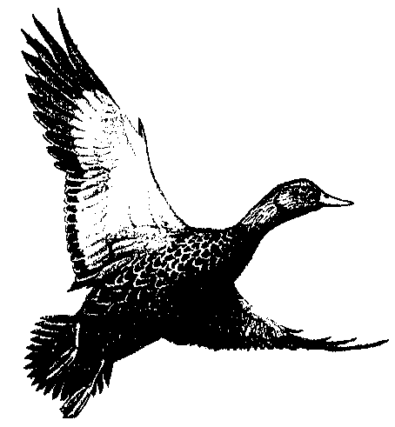
Trends in Waterfowl: Black Duck and Mallard
Black Duck
GOAL: Restore populations and habitats to 1970s levels by the year 2000.
STATUS: The goal for black ducks has not been reached, while the goal for mallards has been achieved.
goal
2004
Mallard
goal
2004
Source: U.S. Fish & Wildlife Service.
Notes:
Hierarchy Level 6 = Changes in Health, Ecology or Other Effects
State biologists and the US Fish and Wildlife Service routinely count at least 20 species or species groups of waterfowl each winter in the Bay watershed. The goal for each species was based on the average number of waterfowl counted in surveys from 1973-1977 or the 1986-1990 average, whichever was greater.
Goal achievement is determined by comparing the goal to the average count for the most recent five years.
Coastal march and island habitat restoration and protection are considered necessary to restore the black duck population.
Nesting habitat preferences are similar for the black duck and mallard, although the mallard will nest in close association with humans. The majority of resident Chesapeake Bay mallards (those here in summer) are semi-domesticated, and often are associated with housing, marinas and other areas of intense human use. Resident mallards may negatively affect black duck populations by competing for nest sites and food resources, or through hybridization with black ducks.
Waterfowl populations are variable because most of the birds are migratory and may not return to the Chesapeake by the time of the survey each year.
Factors outside the basin, such as conditions on the northern breeding grounds, affect Chesapeake populations.
Harvest pressure from hunting and poaching also affect Chesapeake populations.
For more information, contact Doug Forsell at USFWS (410 573-4560) or Mike Fritz at CBPO
(1-800-968-7229, ext. 721).

Slide 41
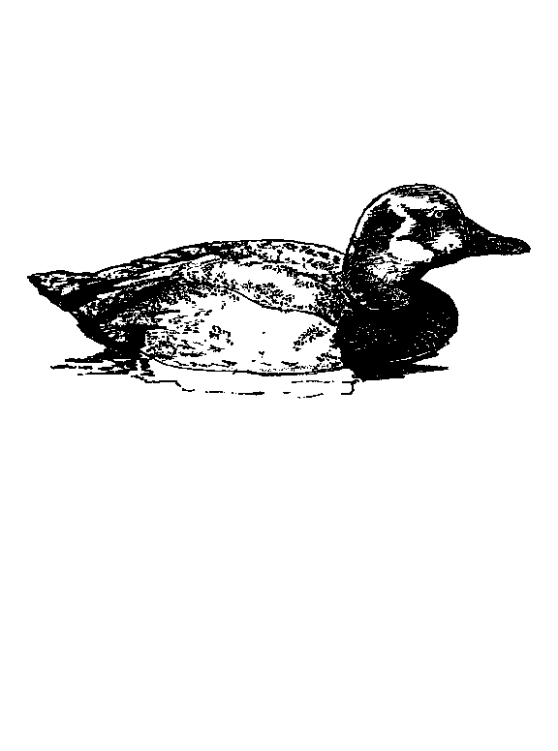
Trends in Diving Ducks
Canvasbacks
Redheads
GOAL: Restore populations and habitats to 1970s levels by the year 2000.
STATUS: Overall, diving ducks are doing well, however, redheads and canvasbacks are below goal levels.
goal
goal
2004
2004
Other Diving Ducks*
Total Diving Ducks
(*Scaup, Ring-necked Ducks, Common Goldeneye, Bufflehead, Ruddy Duck)
goal
goal
2004
2004
Source: U.S. Fish & Wildlife Service.
Notes:
Hierarchy Level 6 = Changes in Health, Ecology or Other Effects
State biologists and the US Fish and Wildlife Service routinely count at least 20 species or species groups of waterfowl each winter in the Bay watershed. The goal for each species was based on the average number of waterfowl counted in surveys from 1973-1977 or the 1986-1990 average, whichever was greater.
Goal achievement is determined by comparing the goal to the average count for the most recent five years.
Diving ducks are considered good indicators of the Chesapeake's water quality because they not only use surface habitat, but dive to feed on bottom-dwelling plants or animals. Chesapeake Bay diving duck species include canvasbacks, redheads, scaup, ring-necked ducks, common goldeneye, bufflehead and ruddy ducks.
Once found Baywide, the redhead population has declined in recent years, with the only significant numbers remaining in the Tangier Sound area.
Redheads are dependent on SAV for food. While both poaching and the loss of SAV have influenced the redhead's decline, it is hoped that a return of SAV will result in a substantial increase of redheads and other diving ducks.
With the decline of SAV, the canvasback modified its diet to include clams. Canvasbacks have to consume large numbers of clams to get the same energy as their former SAV diet. It is not known why the redheads did not also switch their diet to include clams.
Other diving ducks have always depended on clams and other benthic invertebrates for food.
Waterfowl populations are variable, because the birds are migratory and may not return to the Chesapeake by the time of the survey each year.
Factors outside the basin, such as conditions on the northern breeding grounds, affect Chesapeake populations.
Harvest pressure of hunting and poaching also affect Chesapeake populations.
For more information, contact Doug Forsell at USFWS (410 573-4560) or Mike Fritz at CBPO
(1-800-968-7229, ext. 721).

Slide 42
For More Information
www.chesapeakebay.net
www.cbf.org

